Slide 1

Credit card Fraud detection
BIG DATA ANALYTICS PROJECT (IN COLLABORATION WITH NEURONS SOLUTIONS)

Slide 2
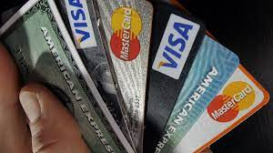
contributors (group members)
Ayesha abbasi
Sabahat tasleem
Sania majid
Laiba khan

Slide 3
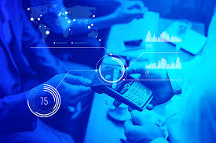
Introduction
Credit card fraud detection is the process of
identifying purchase attempts that are fraudulent
or rejecting rather than processing the
procedure. So there are
variety of tool and
techniques available
for detecting frauds with
the help of different soft wares
working specifically on Machine
learning and Artificial intelligence.

Slide 4
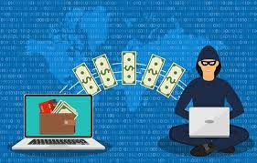
algorithms
KNN (K-Nearest Neighbors) Model for ML
LR (Logistic Regression) Model for ML
Visual Code Studio for coding (Python)
Flask for Connectivity of website
PHP for website
KNN Model had 99% accuracy

Slide 5
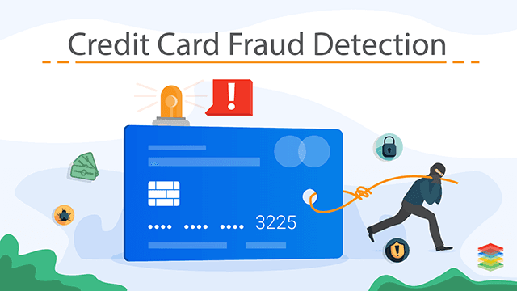
Description
The k-nearest neighbors (KNN) algorithm is a simple, supervised machine learning algorithm that can be used to solve both classification and regression.
LR Model is used for predicting the categorical dependent variable using a given set of independent variables.
Flask is a web application framework written in python. It helps end users to interact with the python code.
Visual Studio Code is a code editor redefined and optimized for building and debugging modern web and cloud applications.
PHP (recursive acronym for PHP: Hypertext Preprocessor ) is a widely-used open source general-purpose scripting language that is especially suited for web

Slide 6
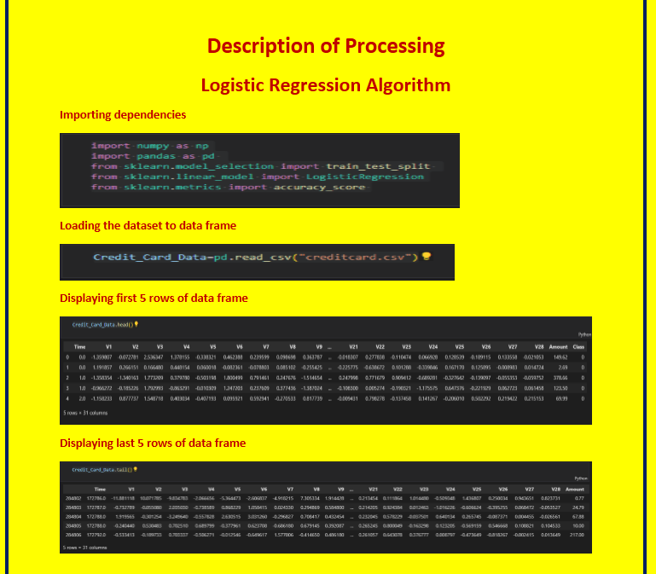
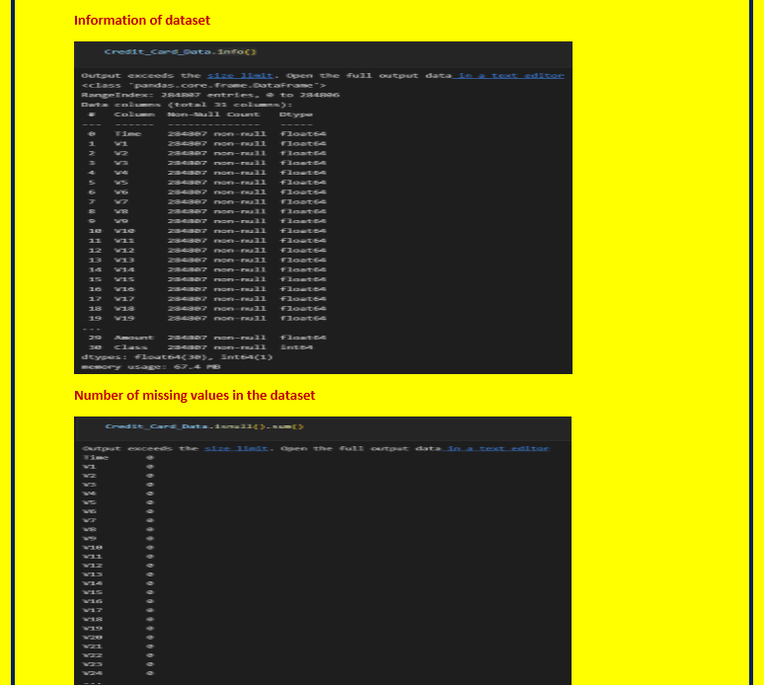
Description of ALGORITHMS (CODINGS)
STEPS INVOLVED:

Slide 7
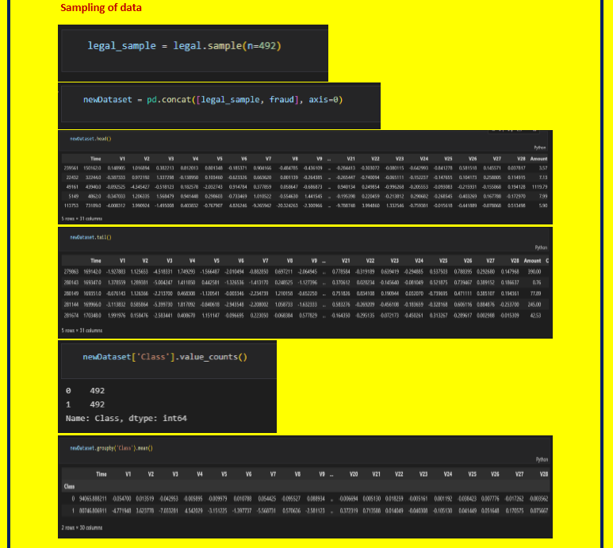
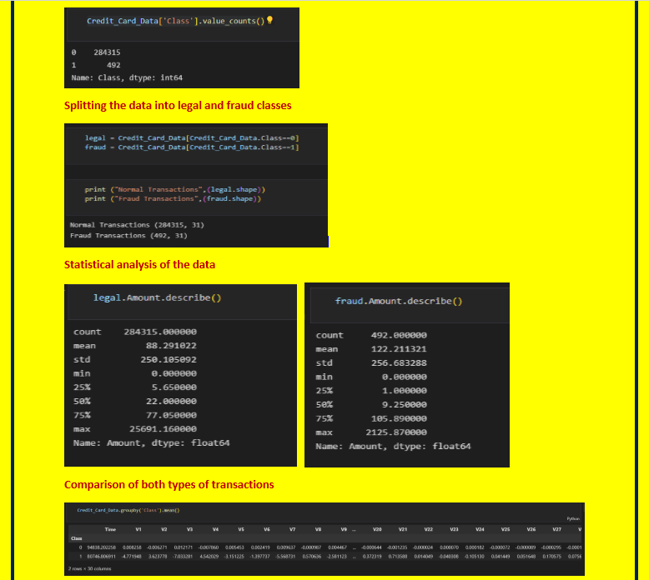
STEPS INVOLVED:

Slide 8
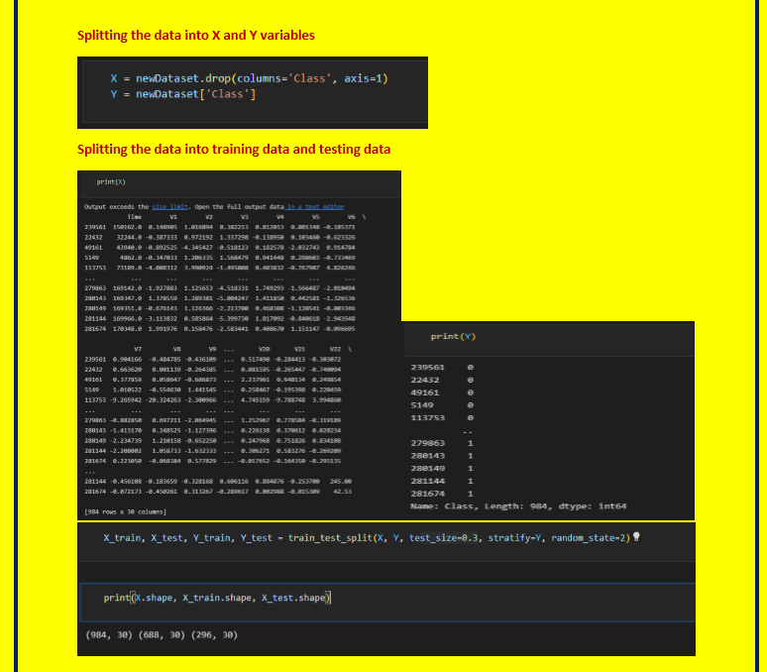
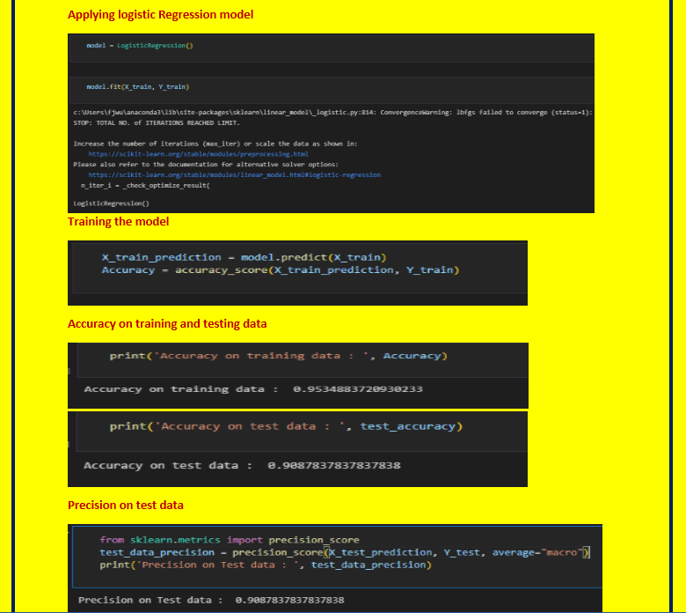
steps involved:

Slide 9
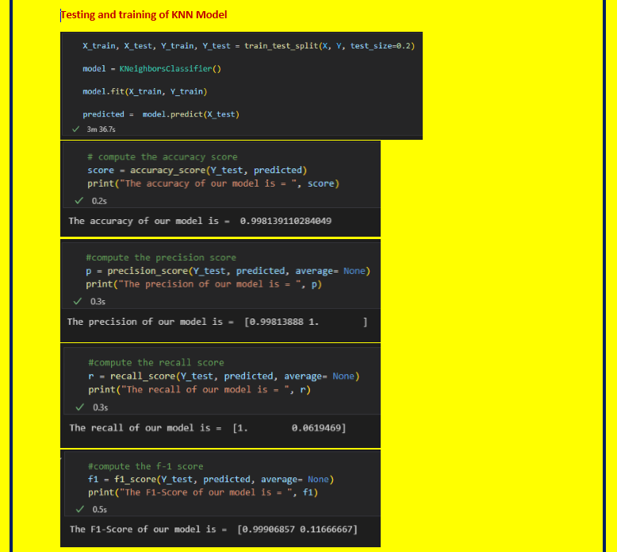
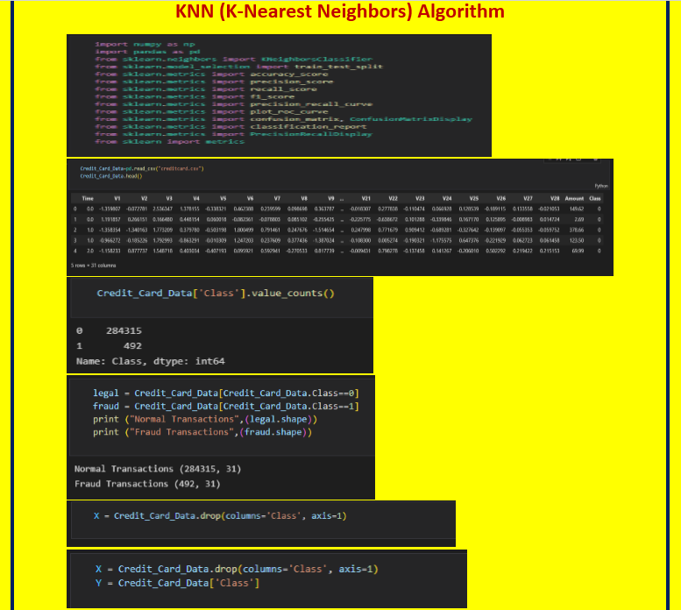
Knn Model steps:

Slide 10

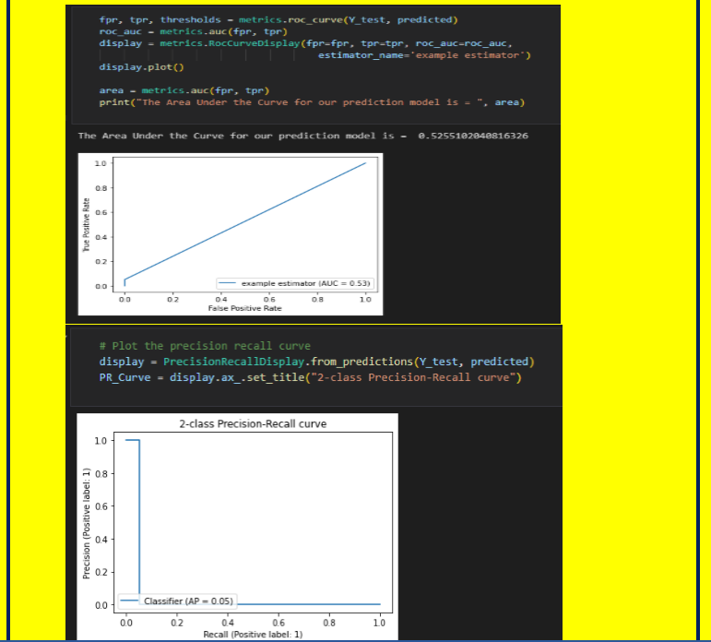

=
prEcision of Machine learning

Slide 11
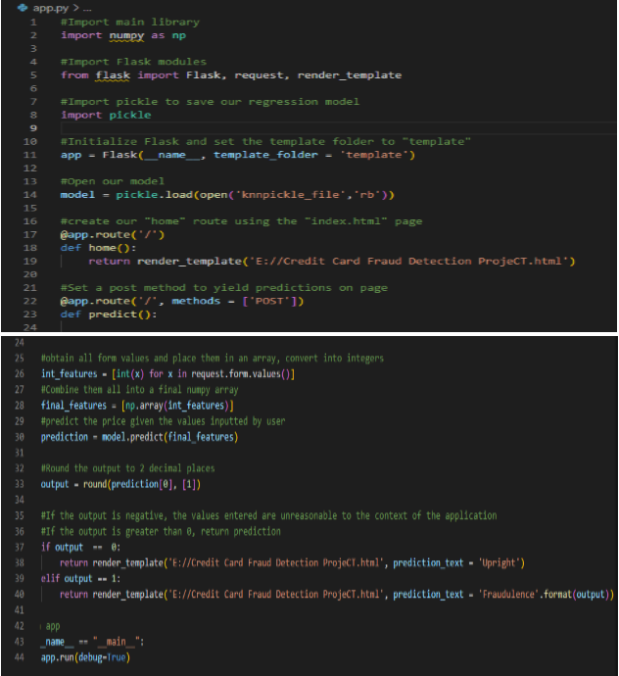

=
Flask connectivity of website with ml model

Slide 12
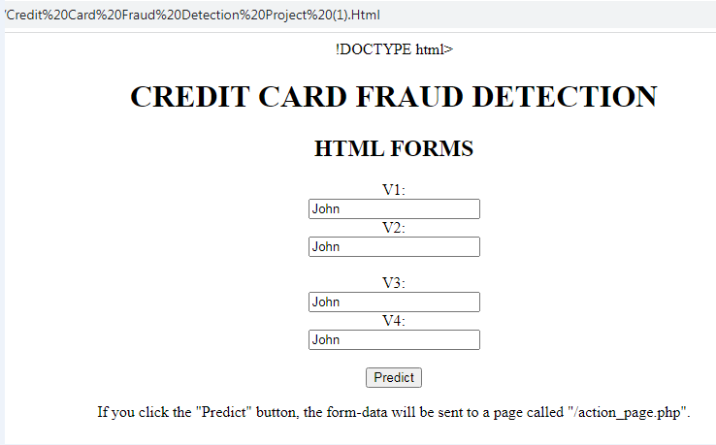
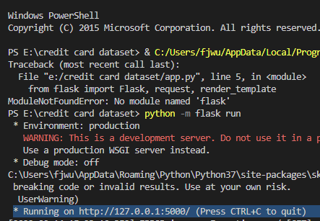
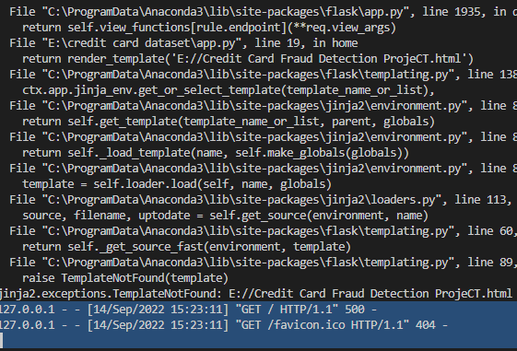
=
Web interface
Web interface
Execution of web application

Slide 13
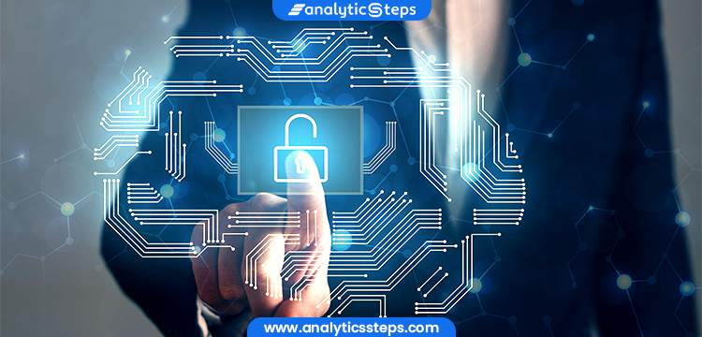
Web links for video and website
Link of short tutorial
https://docs.google.com/presentation/d/1zL-NODFY2_t1n3eGI_tBv3UoOP2Nua91/edit?usp=sharing&ouid=115719917530405020729&rtpof=true&sd=true
Link of website
Credit Card Fraud Detection Project (1).Html
Thank you all for your interest and being attentive

